Slide 1
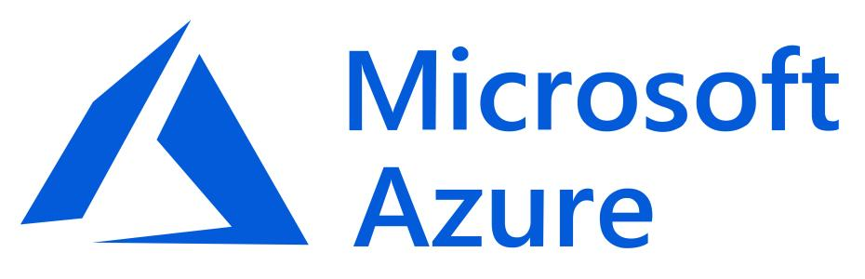
Microsoft Serverless

Slide 2
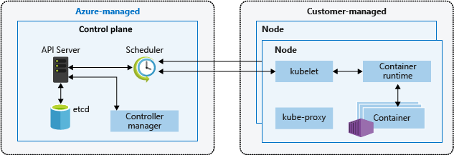
Serverless Computing
Azure Kubernetes Service：
Open-source orchestration software for deploying, managing, and scaling containers.
Provides API that controls how and where those containers will run.
Automatically manages service discovery, incorporates load balancing, tracks resource allocation, and scales based on compute utilization.

Slide 3
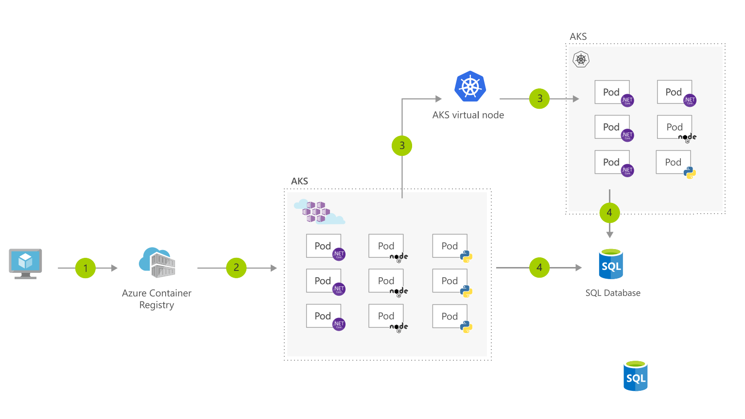
Serverless Computing
Azure Kubernetes Service：

Slide 4
Serverless Computing
Azure Kubernetes Service：
Identity and security management: AKS supports Kubernetes role-based access control (RBAC).
Clusters and nodes:You can connect storage to nodes and pods, upgrade cluster components, and use GPUs.
Virtual networks and ingress: Every pod in the cluster is assigned an IP address in the virtual network, and can directly communicate with other pods in the cluster, and other nodes in the virtual network.
Development tooling integration:Rich ecosystem of development and management tools such as Helm, Draft, and the Kubernetes extension for Visual Studio Code.

Slide 5
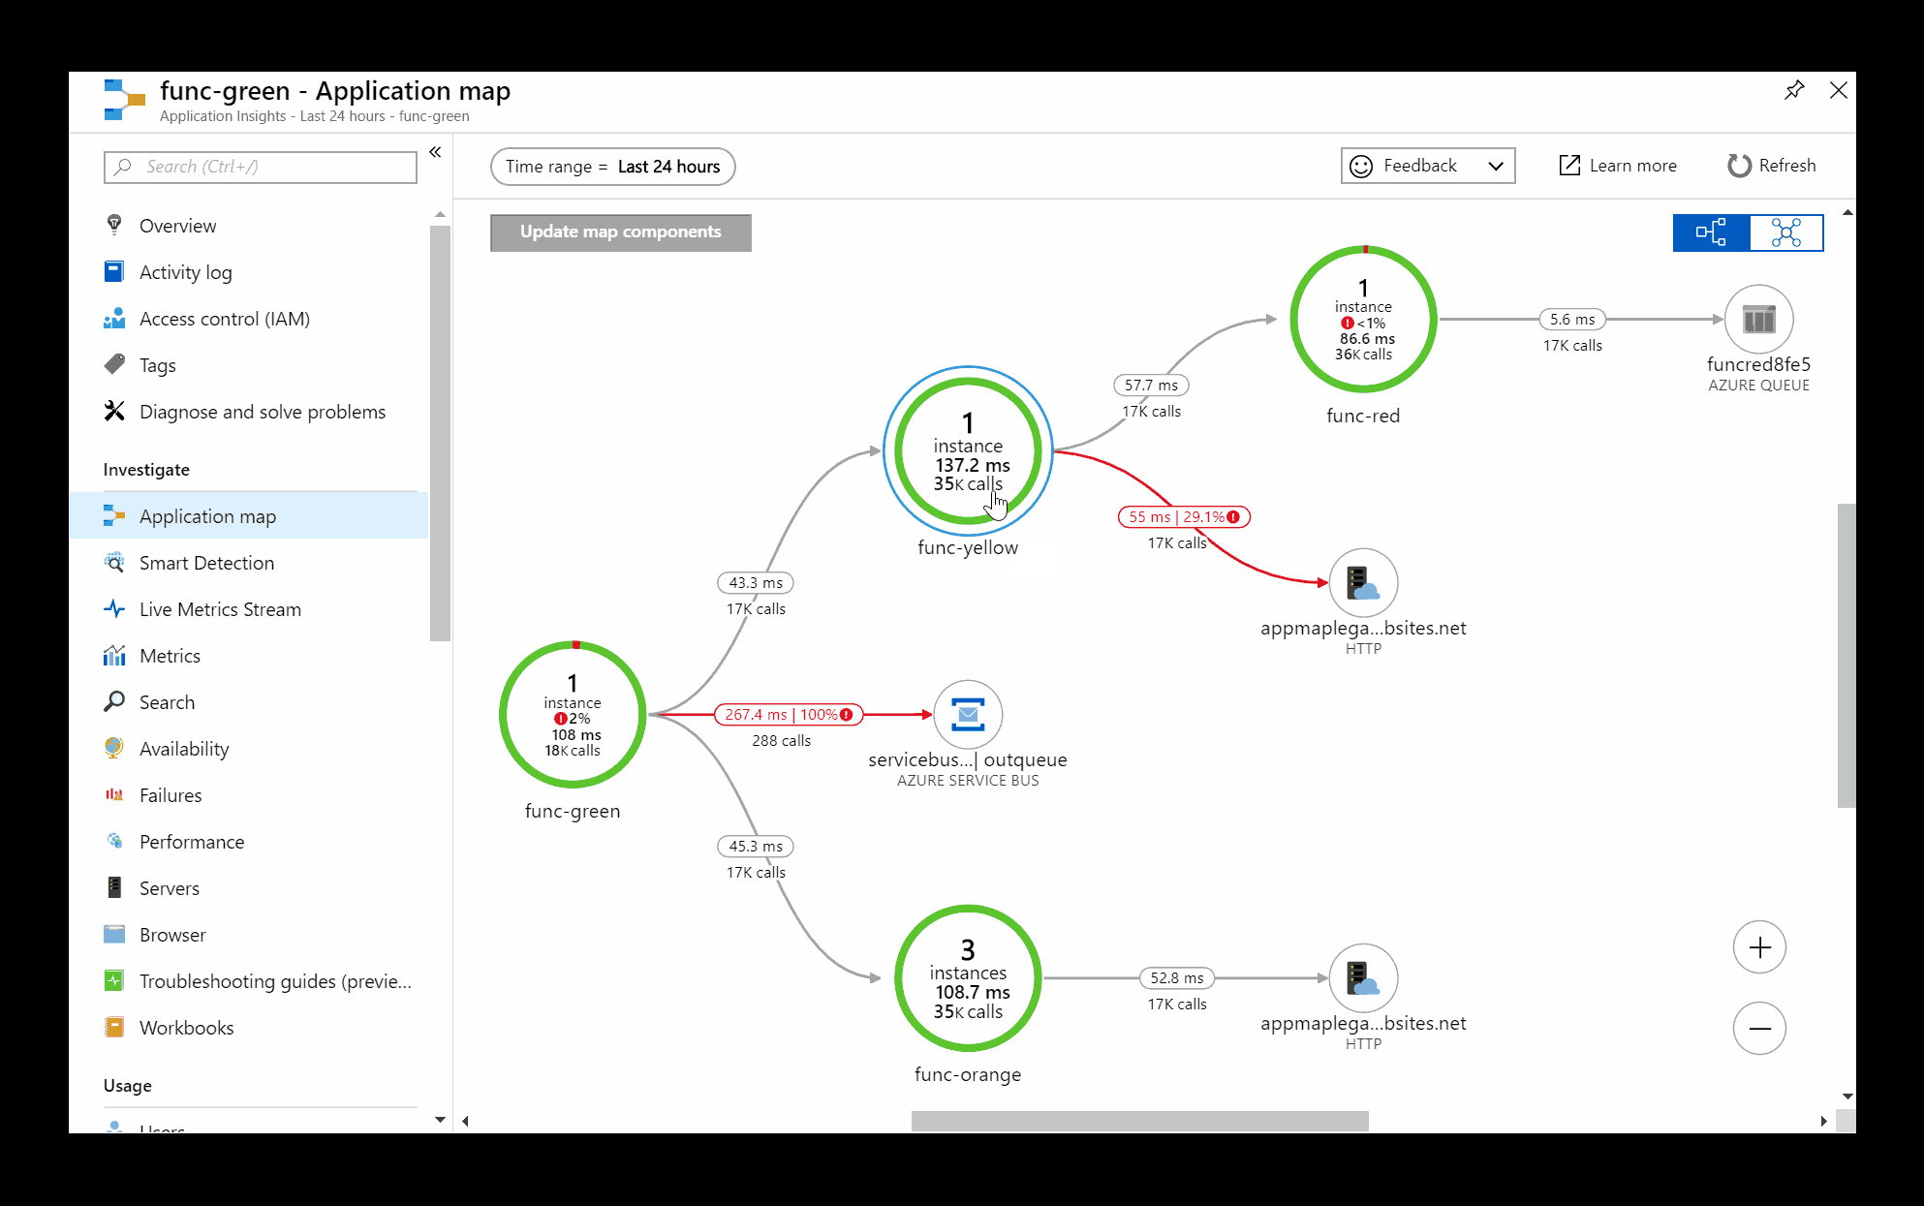
Serverless Computing
Azure Functions：
Intelligent and proactive insights about the performance of applications in production from Azure Monitor. Monitor and analyze code performance with Azure Application Insights. Spot bottlenecks and failure hotspots across all components of your application using application maps with distributed tracing from Azure Monitor.

Slide 6
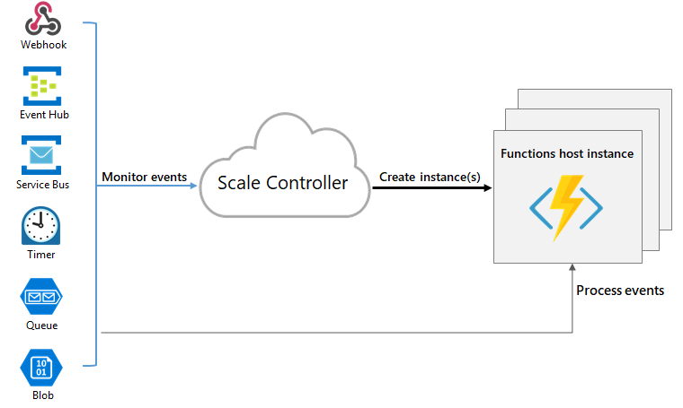
Serverless Computing
Azure Functions：
Pick the Functions plan that matches your business needs, and deploy the same code to multiple targets - from pay-per-execution in the cloud to your Kubernetes cluster or IoT devices for edge computing.
The Azure Functions runtime provides flexibility in hosting where and how you want. KEDA (Kubernetes-based Event Driven Autoscaling) pairs seamlessly with the Azure Functions runtime and tooling to provide event driven scale in Kubernetes.

Slide 7
Serverless Computing
Azure Functions：
Durable Functions is an extension of Azure Functions that lets you write stateful functions in a serverless compute environment. The extension lets you define stateful workflows by writing orchestrator functions and stateful entities by writing entity functions using the Azure Functions programming model. Behind the scenes, the extension manages state, checkpoints, and restarts for you, allowing you to focus on your business logic.
Behind the scenes, the Durable Functions extension is built on top of the Durable Task Framework, an open-source library on GitHub that's used to build workflows in code.

Slide 8
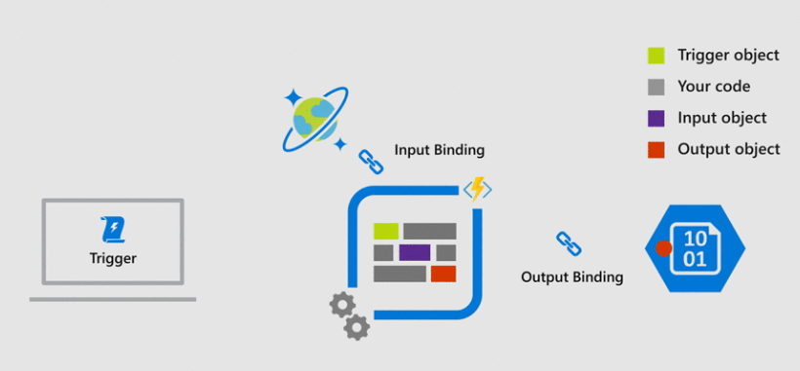
Serverless Computing
Azure Functions：
Pick the programming languages you like best for each unique scenario—from web apps and APIs with .NET, Node.js or Java, to Machine Learning workflows with Python or cloud automation with PowerShell.
The Azure Security Center helps you prevent, detect, and respond to threats with increased visibility into and control over the security of your Azure resources.
Azure functions utilize service triggers as well, but they also capture the idea of bindings. Input and output bindings offer a declarative way to connect to data from within your code.

Slide 9
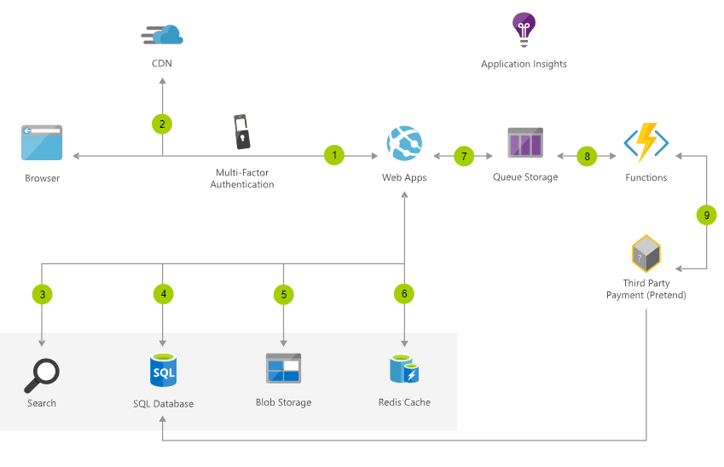
Serverless Computing
Azure App Service：
Run and scale web, mobile, and API applications on the platform of your choice—in a high-productivity, fully managed environment

Slide 10
Serverless Database
Azure Data Lake Analytics：
Azure Data Lake Analytics is an on-demand analytics job service that simplifies big data. Instead of deploying, configuring, and tuning hardware, you write queries to transform your data and extract valuable insights. The analytics service can handle jobs of any scale instantly by setting the dial for how much power you need. You only pay for your job when it is running, making it cost-effective.

Slide 11
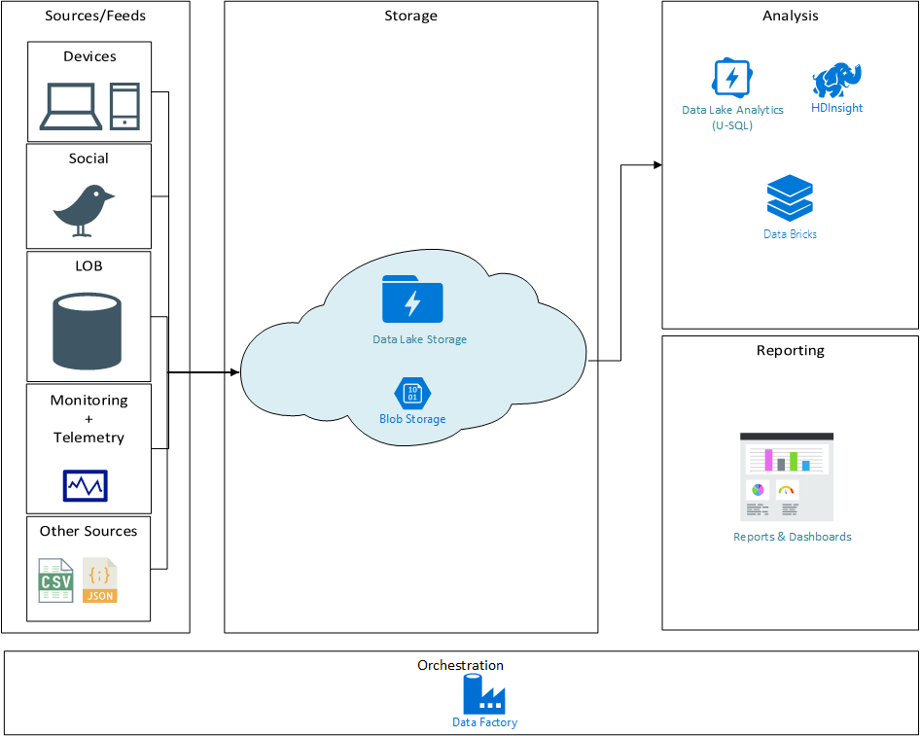
Serverless Database
Azure Data Lake Analytics：
Data Lake analytics is a distributed analytics service built on Apache YARN that compliments the Data Lake store. The analytics service can handle jobs of any scale instantly with on-demand processing power and a pay-as-you-go model that’s very cost effective for short term or on-demand jobs. It includes a scalable distributed runtime called U-SQL, a language that unifies the benefits of SQL with the expressive power of user code.

Slide 12
Serverless Database
Azure Data Lake store：
According to Microsoft, Azure Data Lake store is a hyper-scale repository for big data analytics workloads and a Hadoop Distributed File System (HDFS) for the cloud. It…
Imposes no fixed limits on file size.
Imposes no fixed limits on account size.
Allows unstructured and structured data in their native formats.
Allows massive throughput to increase analytic performance.
Offers high durability, availability, and reliability.
Is integrated with Azure Active Directory access control.

Slide 13
Serverless Database
Azure Data Lake store：
Azure Data Lake store can handle any data in their native format, as is, without requiring prior transformations. Data Lake store does not require a schema to be defined before the data is uploaded, leaving it up to the individual analytic framework to interpret the data and define a schema at the time of the analysis. Being able to store files of arbitrary size and formats makes it possible for Data Lake store to handle structured, semi-structured, and even unstructured data.

